Slide 1
OOP C++

Slide 2
What Is Object Oriented Programming
Object Oriented Programming (OOP) : is a programming paradigm based on the concept of ”objects” .
A programming paradigm : is a style of programming, a way of thinking about software construction.
A programming paradigm does not refer to a specific language but rather to a way to build a program or a methodology to apply.
Some languages make it easy to write in some paradigms but not others .
Some Programming Languages allow the programmer to apply more than one paradigm.

Slide 3
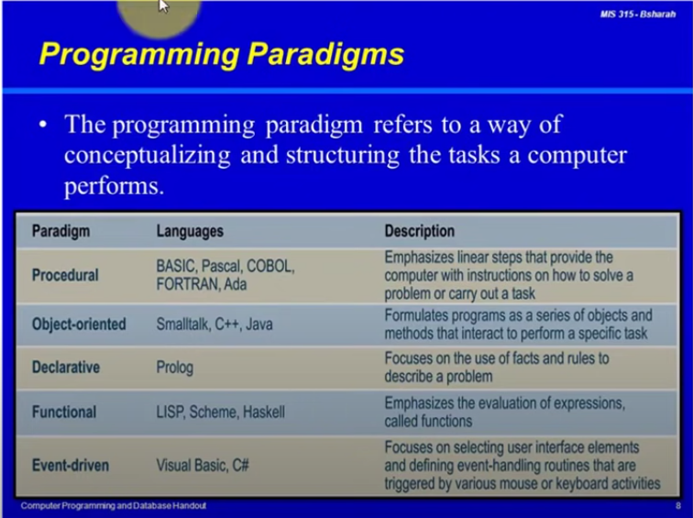
Example of programming paradigm

Slide 4
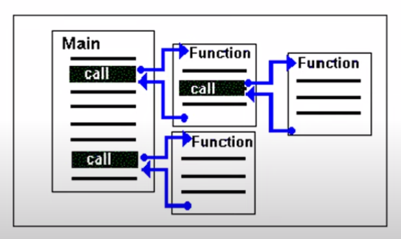
Example of previous programming paradigm
Procedural Programming
Procedural Programming (PP), also known as inline programming takes a top-down approach. It is about writing a list of instruction to tell the computer what to do step by step. It relies on procedures or routines.

Slide 5
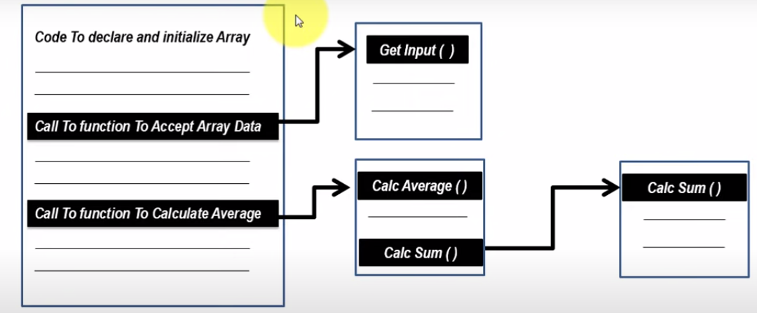
Procedural Programming Example : program to calculate average of array items

Slide 6

Object Oriented Programming (OOP) : is a programming paradigm based on the concept of ”objects” .
Object : is a thing (Tangible -- Intangible)

Slide 7
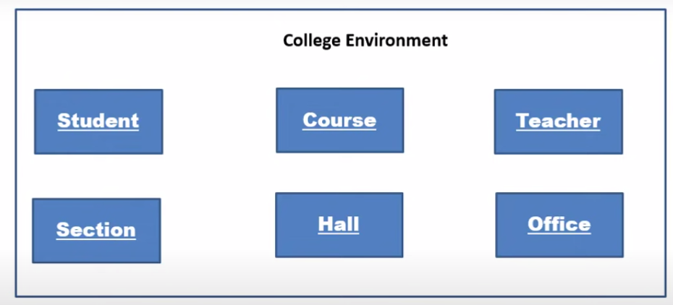
Object in College Management Program
The Object is used when there are a number of things in common (which have specific characteristics and may be different) in a program .
And our software needs and is necessary to store data about it.
Make accounts on it, make permanent updates for it, develop it continuously

Slide 8
If we want to make a program for a college, we need to make a set of Object and we will notice that we will necessarily do Object for:
1) Students:
(note that students share common characteristics and features (and common access possibilities))
** of these characteristics:
name, phone number, university number, university major)
2) Courses:
name, code, data, credit hours.
3) Teacher:
his name, job number, email, courses he is studying, his university major, his last university degree, his assessment, his experience.
4) Hall:
its number, the maximum number of seats, its place, its schedule.
etc...

Slide 9
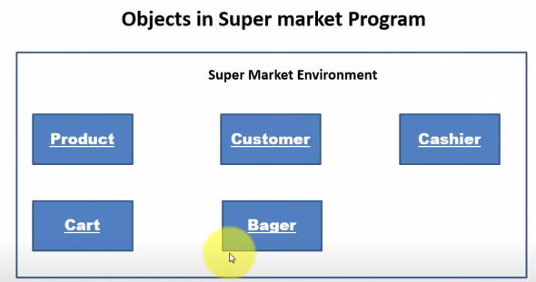

Slide 10
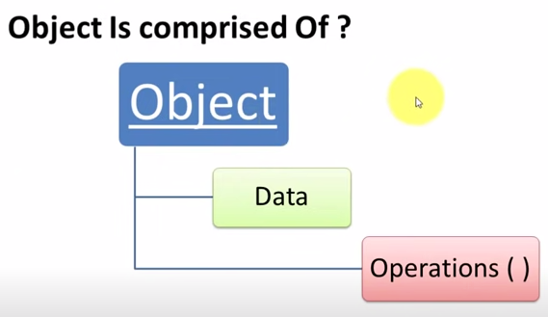
ال (Object Data) :
هي البيانات التي تريد الاحتفاظ بها عن هذا ال (Object).
يلي بتهمك تخزينها و منها بامكانك وصف هذا ال (Obgect)
ال (Object Operations) :
هي مجموعة العمليات (Object) ,او السلوكيات التي سيقوم هذا ال (Object) بها , او ستطلب منه.

Slide 11
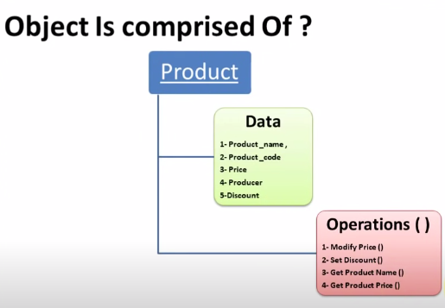

Slide 12
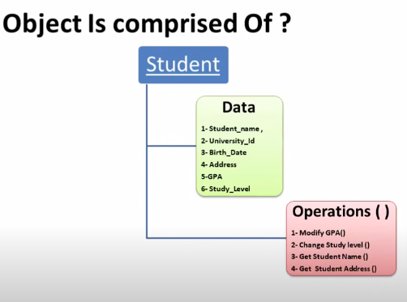

Slide 13
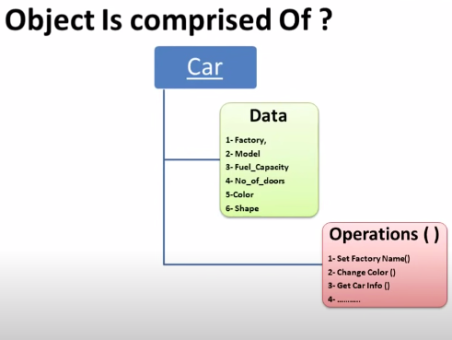

Slide 14
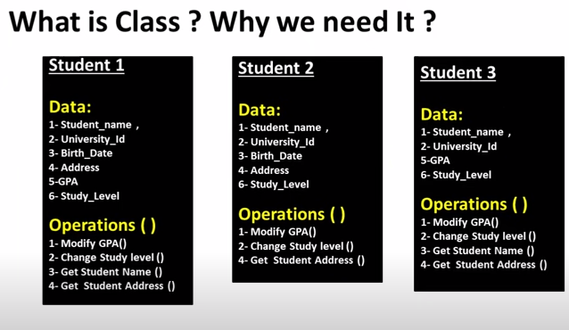
Error

Slide 15
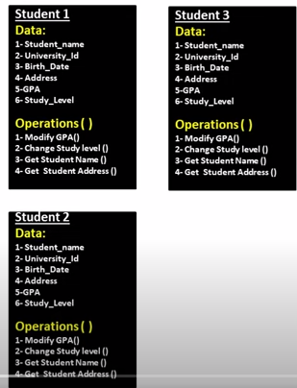
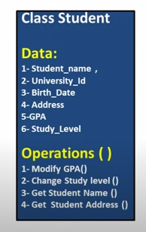
Right

Slide 16
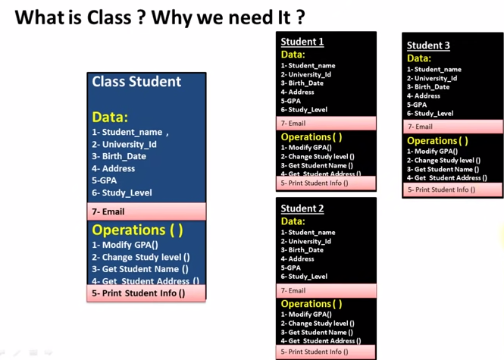
For example, if you want to add a new property to all the (Object) inside the (Class)
Then you need to add it to the ( Class ) which contains all the ( Object ) inside it.

Slide 17
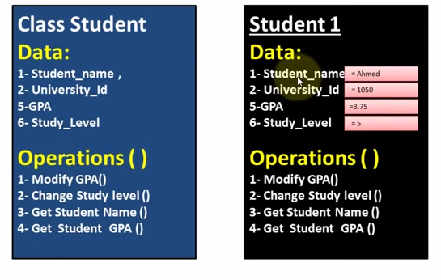

Slide 18
Object and Classes
Classes: Where Object Come From.
A class is code that describes a particular type of object. It specifies the data that an object can hold (the object’s fields), and the action that an object can perform (the object’s methods).
You can think of a class as a code “Blue_Print” that can be used to create a particular type of object.
When a program is running, it can use the class ta create, in memory, as many objects of a specific type as needed.
Each object that is created from a class is called an “instance” of the class.

Slide 19
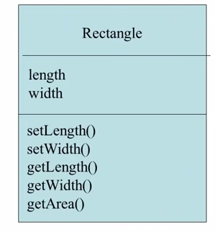
Writing a Class, Step by Step
A (Rectangle) object will have the following fields:

Slide 20
Access Modifiers
An access modifier is a C++ keyword that indicates how a field or method can be accessed.
Public
- When the Public access modifier is applied to a class member, the member can be accessed by code inside the class or outside.
Private
- When the Private access modifier is applied to a class member, the member cannot be accessed by code outside the class. The member can be accessed only by methods that are member of the same class.

Slide 21
Data Hiding
An object hides its internal, private fields from code that is outside the class that the object is an instance of.
Only the class’s method may directly access and change the object’s internal data.
Code outside the class must use the class’s public methods to operate on an object’s private fields.
Data hiding is important because classes are typically used as components in large software systems ,involving a team of programmers.
Data hiding helps enforce the integrity of an object’s internal data.

Slide 22
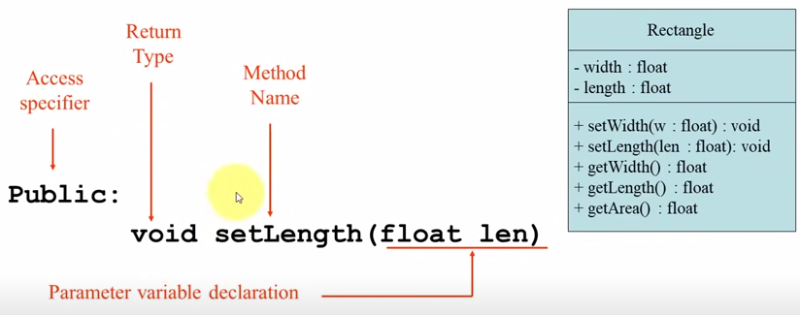

Slide 23
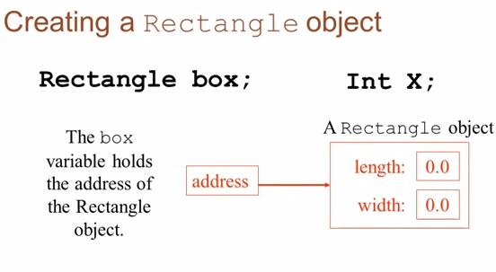

Slide 24
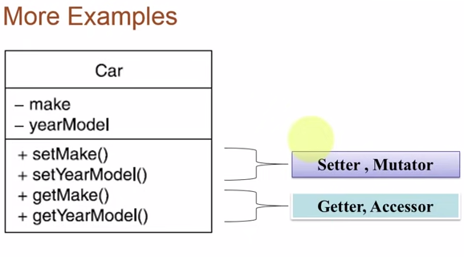

Slide 25
Separating Class Code into 2 files.
The class code can be separated into 2 files:
Header File- .h
Contains the declaration of all the class members.
Only attributes declaration and methods prototypes.
Implementation File- .cpp
Contains the implementation of the class methods.
Client code
Client code, is the one that includes the main function. This file should be stored by the name main.cpp

Slide 26
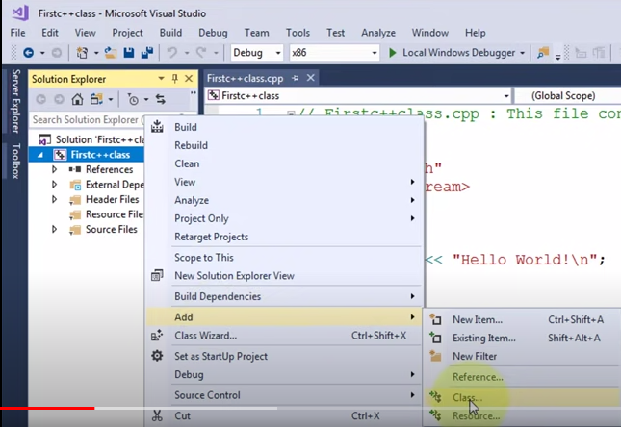
Create class

Slide 27
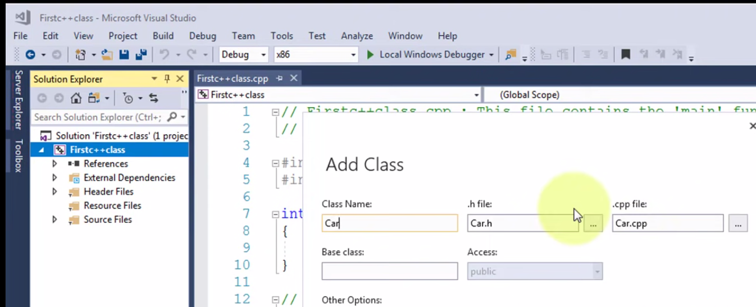

Slide 28
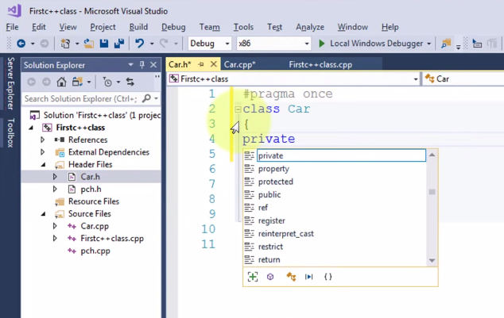

Slide 29
Constructors
welcome
Classes can have special methods called ( Constructors ).
A Constructors is a method that is automatically called when an object is created.
Constructors typically initialize object attributes and perform other object initialization tasks.
Constructors are used to perform operations at the time an object is created.

Slide 30
Constructors
Constructors have a few special properties that set them apart from normal methods.
Constructors have the same name as the class.
Constructors have no return type (not even Void).
Constructors may not return any values.
Constructors are typically public.

Slide 31
Destructor
Good bye
A Destructor is a special method that is automatically called when an object life time is ended.
A Destructor do not have a return value.
The most common use of destructors is to deallocate memory that was allocated for the object by the constructor.

Slide 32
Overloading for Method and Constructors
Two or more methods in a class may have the same name as long as their signatures are different.
Method signature (Number of Args – Types of Args – Order of Args).
When this occurs, it is called (method overloading) , this also applies to constructors.
Method overloading is important because sometimes you need several different ways to perform the same operation.

Slide 33
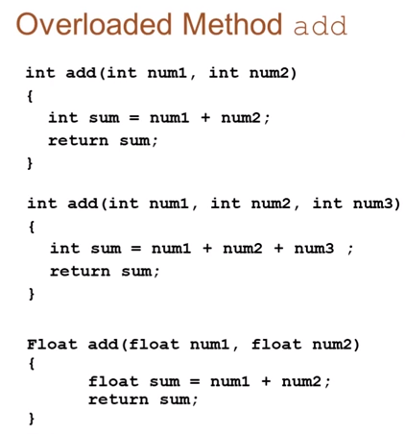

Slide 34
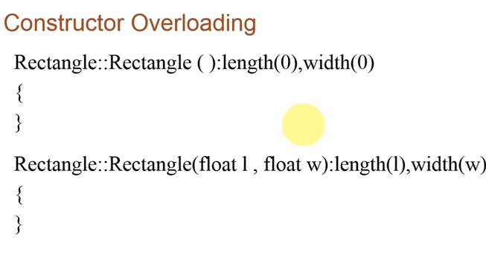

Slide 35
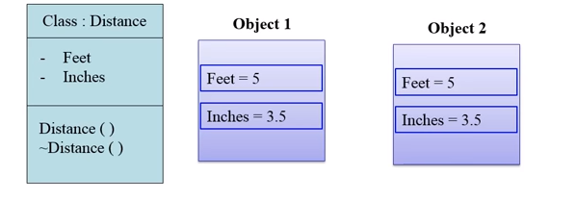
The Default Copy Constructor
It is another way to initialize an object:
Used to initialize an object with another object of the same type.
No need to create a special constructor for this; one is already built into all classes .

Slide 36
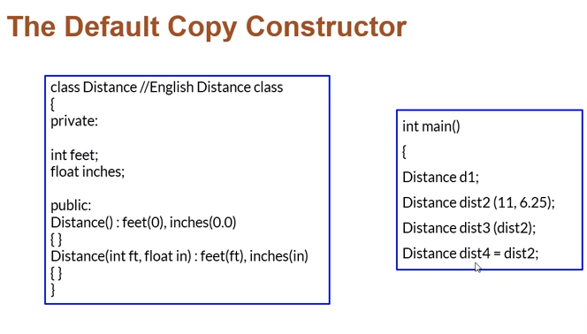

Slide 37
Passing object as Arguments
Objects can be passed to methods as arguments.
When an object is passed as an argument, the value of the reference variable is passed.
The value of the reference variable is an address or reference to the object in memory.
A copy of the object is not passed, just a pointer to the object.
When a method receives a reference variable as an argument, it is possible for the method to modify the contents of the object referenced by the variable.

Slide 38
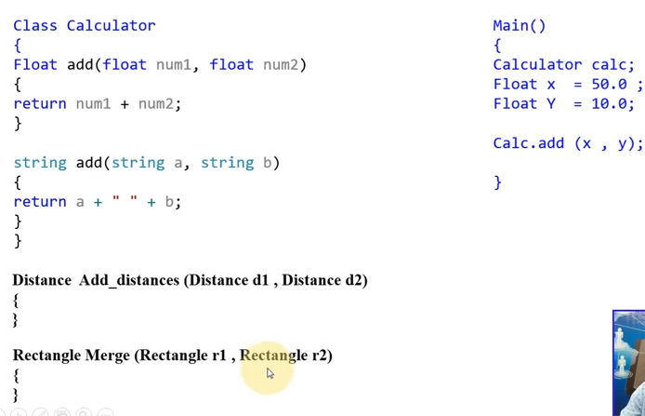
Passing objects To Methods

Slide 39
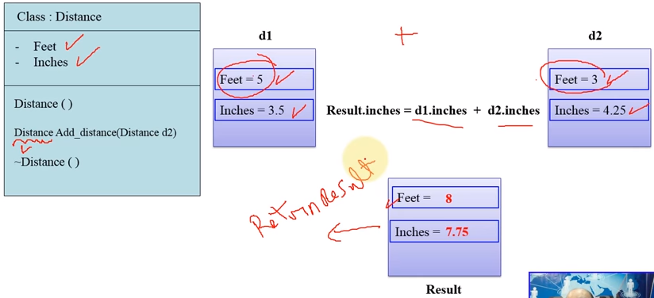

Slide 40
Static Class Members
Static fields and static methods do not belong to a single instance of a class.
A static data item is useful when all objects of all same class must share a common information.
Its lifetime is the entire program. It continues to exist even if there are no objects of the class.
To invoke a static method or a static field, use the class name , rether than the instance name.

Slide 41
Static Methods
Static methods are convenient because they may be called at the class level.
They are typically used to create utility classes.
Static methods may not communicate with instance fields, only static fields.

Slide 42
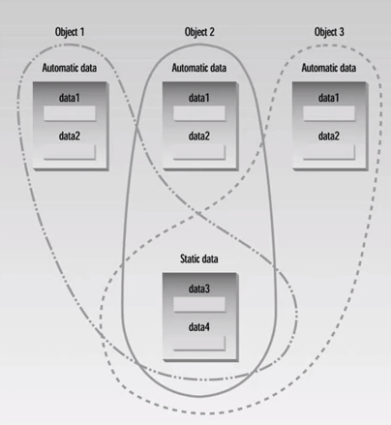
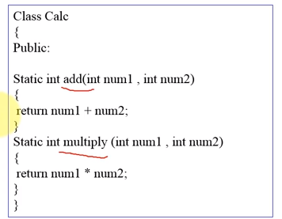

Slide 43
Operator Overloading
The term operator overloading refers to giving the normal C++ operators, such as +,*,<= and +=, additional meanings when they are applied to user-defined data types.
Operator Overloading is one of the most exciting features of object-oriented programming.
It can transform complex program listing into easy ones.
The operator Keyword is used to overload operators.

Slide 44
